Slide 1
CSE-4243: Machine Learning
Introduction
Courtesy @ Raymond J. Mooney , University of Texas at Austin

Slide 2
What is Learning?
Herbert Simon: “Learning is any process by which a system improves performance from experience.”
What is the task?
  Classification
  Problem solving / planning / control

Slide 3
Classification
Assign object/event to one of a given finite set of categories.
  Medical diagnosis
  Credit card applications or transactions
  Fraud detection in e-commerce
  Worm detection in network packets
  Spam filtering in email
  Recommended articles in a newspaper
  Recommended books, movies, music, or jokes
  Financial investments
  DNA sequences
  Spoken words
  Handwritten letters
  Astronomical images

Slide 4
Problem Solving / Planning / Control
Performing actions in an environment in order to achieve a goal.
  Solving calculus problems
  Playing checkers, chess, or backgammon
  Balancing a pole
  Driving a car or a jeep
  Flying a plane, helicopter, or rocket
  Controlling an elevator
  Controlling a character in a video game
  Controlling a mobile robot

Slide 5
Measuring Performance
Classification Accuracy
Solution correctness
Solution quality (length, efficiency)
Speed of performance

Slide 6
Why Study Machine Learning?
Engineering Better Computing Systems
Develop systems that are too difficult/expensive to construct manually because they require specific detailed skills or knowledge tuned to a specific task (knowledge engineering bottleneck).
Develop systems that can automatically adapt and customize themselves to individual users.
  Personalized news or mail filter
  Personalized tutoring
Discover new knowledge from large databases (data mining).
  Market basket analysis (e.g. diapers and beer)
  Medical text mining (e.g. migraines to calcium channel blockers to magnesium)

Slide 7
Why Study Machine Learning?
Cognitive Science
Computational studies of learning may help us understand learning in humans and other biological organisms.
  Hebbian neural learning
    “Neurons that fire together, wire together.”
  Human’s relative difficulty of learning disjunctive concepts vs. conjunctive ones.
  Power law of practice
log(perf. time)
log(# training trials)

Slide 8
Why Study Machine Learning?
The Time is Ripe
Many basic effective and efficient algorithms available.
Large amounts of on-line data available.
Large amounts of computational resources available.

Slide 9
Related Disciplines
Artificial Intelligence
Data Mining
Probability and Statistics
Information theory
Numerical optimization
Computational complexity theory
Control theory (adaptive)
Psychology (developmental, cognitive)
Neurobiology
Linguistics
Philosophy

Slide 10
Defining the Learning Task
Improve on task, T, with respect to
performance metric, P, based on experience, E.
T: Playing checkers
P: Percentage of games won against an arbitrary opponent
E: Playing practice games against itself
T: Recognizing hand-written words
P: Percentage of words correctly classified
E: Database of human-labeled images of handwritten words
T: Driving on four-lane highways using vision sensors
P: Average distance traveled before a human-judged error
E: A sequence of images and steering commands recorded while
observing a human driver.
T: Categorize email messages as spam or legitimate.
P: Percentage of email messages correctly classified.
E: Database of emails, some with human-given labels

Slide 11
Designing a Learning System
Choose the training experience
Choose exactly what is too be learned, i.e. the target function.
Choose how to represent the target function.
Choose a learning algorithm to infer the target function from the experience.
Learner
Environment/
Experience
Knowledge
Performance
Element

Slide 12
Sample Learning Problem
Learn to play checkers from self-play
  (https://youtu.be/MOW9k_C4vFU)
Develop an approach analogous to that used in the first machine learning system developed by Arthur Samuels at IBM in 1959.

Slide 13
Training Experience
Direct experience: Given sample input and output pairs for a useful target function.
  Checker boards labeled with the correct move, e.g. extracted from record of expert play
Indirect experience: Given feedback which is not direct I/O pairs for a useful target function.
  Potentially arbitrary sequences of game moves and their final game results.
Credit/Blame Assignment Problem: How to assign credit blame to individual moves given only indirect feedback?

Slide 14
Source of Training Data
Provided random examples outside of the learner’s control.
  Negative examples available or only positive?
Good training examples selected by a “benevolent teacher.”
  “Near miss” examples
Learner can query an oracle about class of an unlabeled example in the environment.
Learner can construct an arbitrary example and query an oracle for its label.
Learner can design and run experiments directly in the environment without any human guidance.

Slide 15
Training vs. Test Distribution
Generally assume that the training and test examples are independently drawn from the same overall distribution of data.
  IID: Independently and identically distributed
If examples are not independent, requires collective classification.
If test distribution is different, requires transfer learning.

Slide 16
Choosing a Target Function
What function is to be learned and how will it be used by the performance system?
For checkers, assume we are given a function for generating the legal moves for a given board position and want to decide the best move.
  Could learn a function:
  ChooseMove(board, legal-moves) → best-move
  Or could learn an evaluation function, V(board) → R, that gives each board position a score for how favorable it is. V can be used to pick a move by applying each legal move, scoring the resulting board position, and choosing the move that results in the highest scoring board position.
  (https://youtu.be/MOW9k_C4vFU)

Slide 17
Ideal Definition of V(b)
If b is a final winning board, then V(b) = 100
If b is a final losing board, then V(b) = –100
If b is a final draw board, then V(b) = 0
Otherwise, then V(b) = V(b´), where b´ is the highest scoring final board position that is achieved starting from b and playing optimally until the end of the game (assuming the opponent plays optimally as well).
  Can be computed using complete mini-max search of the finite game tree.

Slide 18
Approximating V(b)
Computing V(b) is intractable since it involves searching the complete exponential game tree.
Therefore, this definition is said to be non-operational.
An operational definition can be computed in reasonable (polynomial) time.
Need to learn an operational approximation to the ideal evaluation function.

Slide 19
Representing the Target Function
Target function can be represented in many ways: lookup table, symbolic rules, numerical function, neural network.
There is a trade-off between the expressiveness of a representation and the ease of learning.
The more expressive a representation, the better it will be at approximating an arbitrary function; however, the more examples will be needed to learn an accurate function.

Slide 20
Linear Function for Representing V(b)
In checkers, use a linear approximation of the evaluation function.
  bp(b): number of black pieces on board b
  rp(b): number of red pieces on board b
  bk(b): number of black kings on board b
  rk(b): number of red kings on board b
  bt(b): number of black pieces threatened (i.e. which can be immediately taken by red on its next turn)
  rt(b): number of red pieces threatened

Slide 21
Obtaining Training Values
Direct supervision may be available for the target function.
  < <bp=3,rp=0,bk=1,rk=0,bt=0,rt=0>, 100> (win for black)
With indirect feedback, training values can be estimated using temporal difference learning (used in reinforcement learning where supervision is delayed reward).

Slide 22
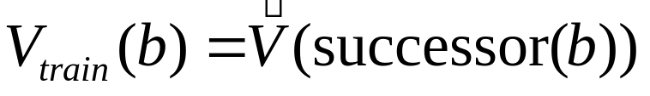
Temporal Difference Learning
Estimate training values for intermediate (non-terminal) board positions by the estimated value of their successor in an actual game trace.
where successor(b) is the next board position where it is the program’s move in actual play.
Values towards the end of the game are initially more accurate and continued training slowly “backs up” accurate values to earlier board positions.

Slide 23
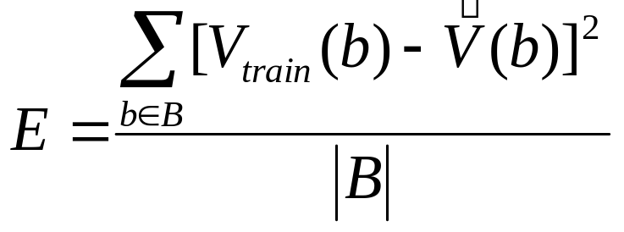
Learning Algorithm
Uses training values for the target function to induce a hypothesized definition that fits these examples and hopefully generalizes to unseen examples.
In statistics, learning to approximate a continuous function is called regression.
Attempts to minimize some measure of error (loss function) such as mean squared error:

Slide 24
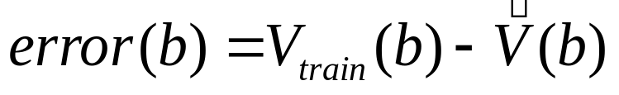
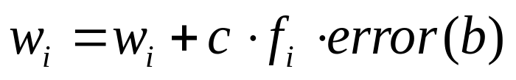
Least Mean Squares (LMS) Algorithm
A gradient descent algorithm that incrementally updates the weights of a linear function in an attempt to minimize the mean squared error
Until weights converge :
For each training example b do :
1) Compute the absolute error :
2) For each board feature, f_{i}, update its weight, w_{i} :
for some small constant (learning rate) c

Slide 25
LMS Discussion
Intuitively, LMS executes the following rules:
  If the output for an example is correct, make no change.
  If the output is too high, lower the weights proportional to the values of their corresponding features, so the overall output decreases
  If the output is too low, increase the weights proportional to the values of their corresponding features, so the overall output increases.
Under the proper weak assumptions, LMS can be proven to eventetually converge to a set of weights that minimizes the mean squared error.

Slide 26
Lessons Learned about Learning
Learning can be viewed as using direct or indirect experience to approximate a chosen target function.
Function approximation can be viewed as a search through a space of hypotheses (representations of functions) for one that best fits a set of training data.
Different learning methods assume different hypothesis spaces (representation languages) and/or employ different search techniques.

Slide 27
Various Function Representations
Numerical functions
  Linear regression
  Neural networks
  Support vector machines
Symbolic functions
  Decision trees
  Rules in propositional logic
  Rules in first-order predicate logic
Instance-based functions
  Nearest-neighbor
  Case-based
Probabilistic Graphical Models
  Naïve Bayes
  Bayesian networks
  Hidden-Markov Models (HMMs)
  Probabilistic Context Free Grammars (PCFGs)
  Markov networks

Slide 28
Various Search Algorithms
Gradient descent
  Perceptron
  Backpropagation
Dynamic Programming
  HMM Learning
  PCFG Learning
Divide and Conquer
  Decision tree induction
  Rule learning
Evolutionary Computation
  Genetic Algorithms (GAs)
  Genetic Programming (GP)
  Neuro-evolution

Slide 29
Evaluation of Learning Systems
Experimental
  Conduct controlled cross-validation experiments to compare various methods on a variety of benchmark datasets.
  Gather data on their performance, e.g. test accuracy, training-time, testing-time.
  Analyze differences for statistical significance.
Theoretical
  Analyze algorithms mathematically and prove theorems about their:
    Computational complexity
    Ability to fit training data
    Sample complexity (number of training examples needed to learn an accurate function)

Slide 30
History of Machine Learning
1950s
  Samuel’s checker player
  Selfridge’s Pandemonium
1960s:
  Neural networks: Perceptron
  Pattern recognition
  Learning in the limit theory
  Minsky and Papert prove limitations of Perceptron
1970s:
  Symbolic concept induction
  Winston’s arch learner
  Expert systems and the knowledge acquisition bottleneck
  Quinlan’s ID3
  Michalski’s AQ and soybean diagnosis
  Scientific discovery with BACON
  Mathematical discovery with AM

Slide 31
History of Machine Learning (cont.)
1980s:
  Advanced decision tree and rule learning
  Explanation-based Learning (EBL)
  Learning and planning and problem solving
  Utility problem
  Analogy
  Cognitive architectures
  Resurgence of neural networks (connectionism, backpropagation)
  Valiant’s PAC Learning Theory
  Focus on experimental methodology
1990s
  Data mining
  Adaptive software agents and web applications
  Text learning
  Reinforcement learning (RL)
  Inductive Logic Programming (ILP)
  Ensembles: Bagging, Boosting, and Stacking
  Bayes Net learning

Slide 32
History of Machine Learning (cont.)
2000s
  Support vector machines
  Kernel methods
  Graphical models
  Statistical relational learning
  Transfer learning
  Sequence labeling
  Collective classification and structured outputs
  Computer Systems Applications
    Compilers
    Debugging
    Graphics
    Security (intrusion, virus, and worm detection)
  E mail management
  Personalized assistants that learn
  Learning in robotics and vision

